Slide 1

Market analysis
Notes:
4-5 mins

Slide 2

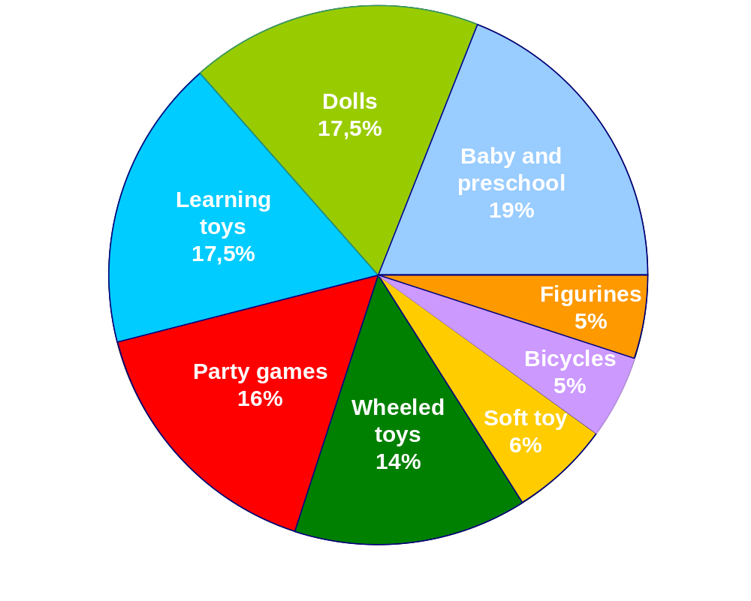
Global toy market segmentation without videogames

Slide 3
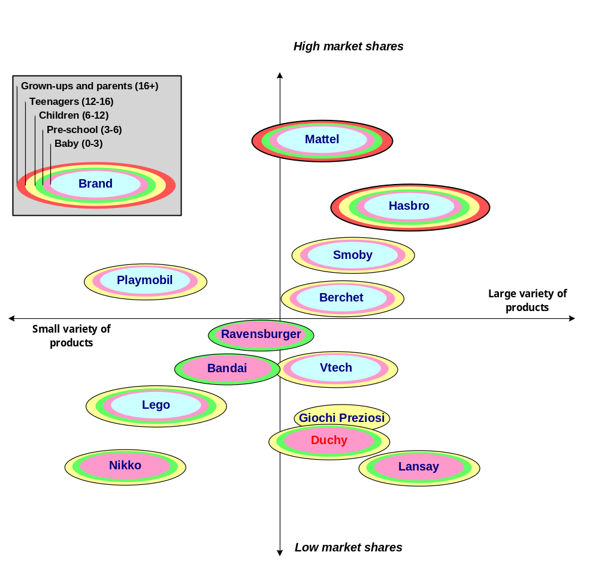
French toys/games market (without video games)

